Slide 1
Fundamentals of Data Science 21CSS202T

Slide 2
Unit I
Unit-1: INTRODUCTION TO DATA SCIENCE 9 hours
Benefits and uses of Data science, Facets of data, The data science process
Introduction to Python Libraries: Numpy, creating array, attributes, Numpy Arrays objects: Creating Arrays, basic operations (Array Join, split, search, sort), Indexing, Slicing and iterating, copying arrays, Arrays shape manipulation, Identity array, eye function, Universal function, Linear algebra with Numpy, eigen values and eigen vectors with Numpy, Numpy Random: Data Distribution, Normal, Exponential, Binomial, Poisson, Uniform and ChiSaquare distributions.
T1: Using Numpy implement Array Indexing and slicing
T2: Using Numpy implement Array basic operations
T3: Using Numpy implement Linear algebra and Random package

Slide 3
Big Data vs Data Science
Big data is a blanket term for any collection of data sets so large or complex that it becomes difficult to process them using traditional data management techniques such as, for example, the RDBMS (relational database management systems).
Data science involves using methods to analyze massive amounts of data and extract the knowledge it contains.
You can think of the relationship between big data and data science as being like the relationship between crude oil and an oil refinery.

Slide 4
Characteristics of Big Data
Volume—How much data is there?
Variety—How diverse are different types of data?
Velocity—At what speed is new data generated?

Slide 5
Benefits and uses of data science and big data
1. It’s in Demand
2. Abundance of Positions
3. A Highly Paid Career
4. Data Science is Versatile
5. Data Science Makes Data Better
6. Data Scientists are Highly Prestigious
7. No More Boring Tasks
8. Data Science Makes Products Smarter
9. Data Science can Save Lives

Slide 6
Facets of data
■ Structured
■ Unstructured
■ Natural language
■ Machine-generated
■ Graph-based
■ Audio, video, and images
■ Streaming

Slide 7
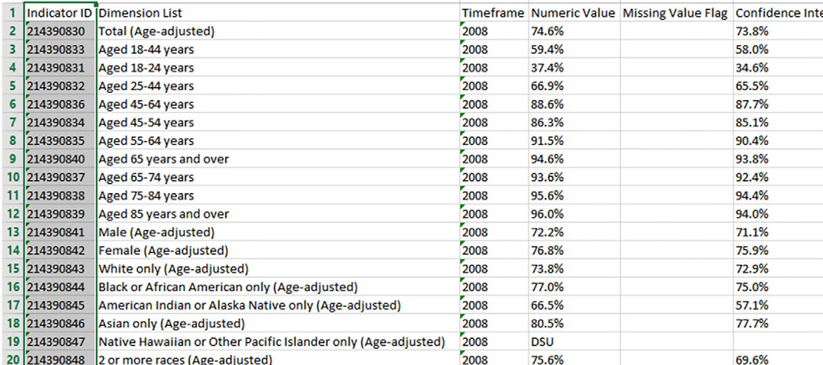
Structured Data
Structured data is data that depends on a data model and resides in a fixed field within a record.

Slide 8

Unstructured data
Unstructured data is data that isn’t easy to fit into a data model because the content is context-specific or varying.

Slide 9
Natural language
Natural language is a special type of unstructured data; it’s challenging to process because it requires knowledge of specific data science techniques and linguistics.
The natural language processing community has had success in entity recognition, topic recognition, summarization, text completion, and sentiment analysis, but models trained in one domain don’t generalize well to other domains.

Slide 10
Machine-generated data
Machine-generated data is information that’s automatically created by a computer, process, application, or other machine without human intervention.
Machine-generated data is becoming a major data resource and will continue to do so.

Slide 11
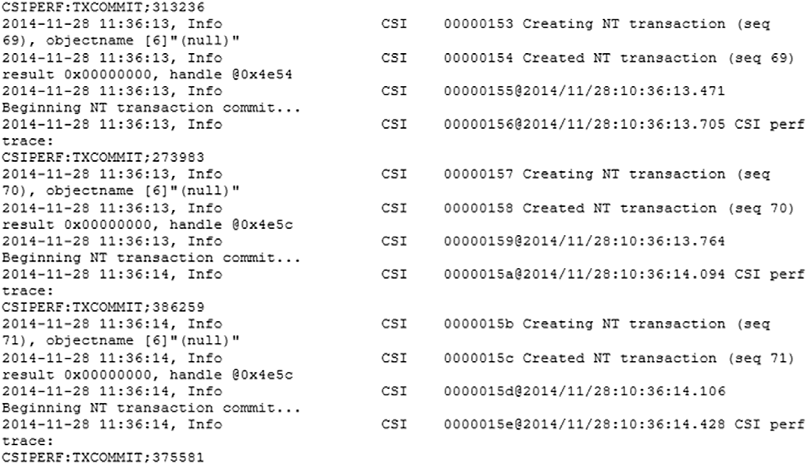
Machine-generated data

Slide 12
Graph-based or network data
“Graph data” can be a confusing term because any data can be shown in a graph.
“Graph” in this case points to mathematical graph theory.
In graph theory, a graph is a mathematical structure to model pair-wise relationships between objects.
Graph or network data is, in short, data that focuses on the relationship or adjacency of objects.
The graph structures use nodes, edges, and properties to represent and store graphical data.
Graph-based data is a natural way to represent social networks, and its structure allows you to calculate specific metrics such as the influence of a person and the shortest path between two people.

Slide 13
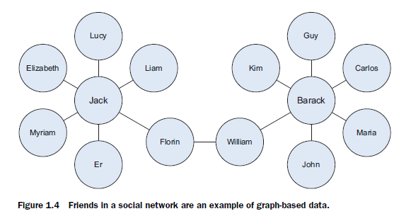
Graph-based or network data

Slide 14

Audio, video and image
Audio, image, and video are data types that pose specific challenges to a data scientist.

Slide 15

Streaming
While streaming data can take almost any of the previous forms, it has an extra property.
The data flows into the system when an event happens instead of being loaded into a data store in a batch.

Slide 16
The Data Science Process

Slide 17
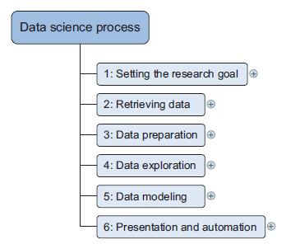
The Data Science Process
The data science process typically consists of six steps, as you can see in the mind map

Slide 18
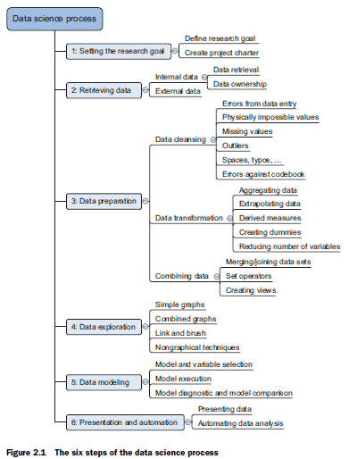
The Data Science Process

Slide 19
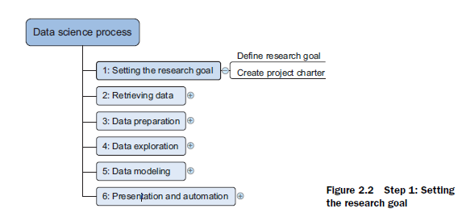
Setting the research goal

Slide 20
Setting the research goal
Data science is mostly applied in the context of an organization.
A clear research goal
The project mission and context
How you’re going to perform your analysis
What resources you expect to use
Proof that it’s an achievable project, or proof of concepts
Deliverables and a measure of success
A timeline

Slide 21
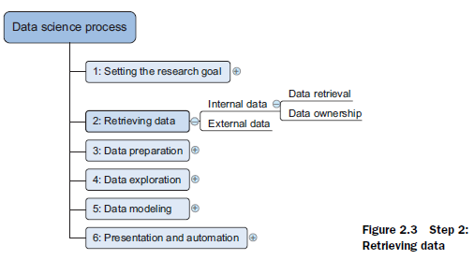
Retrieving data

Slide 22
Retrieving data
Data can be stored in many forms, ranging from simple text files to tables in a database.
The objective now is acquiring all the data you need.
Start with data stored within the company
Databases
Data marts
Data warehouses
Data lakes

Slide 23
Data Lakes
A data lake is a centralized storage repository that holds a massive amount of structured and unstructured data.
According to Gartner, “it is a collection of storage instances of various data assets additional to the originating data sources.”

Slide 24
Data warehouse
Data warehousing is about the collection of data from varied sources for meaningful business insights.
An electronic storage of a massive amount of information, it is a blend of technologies that enable the strategic use of data!

Slide 25
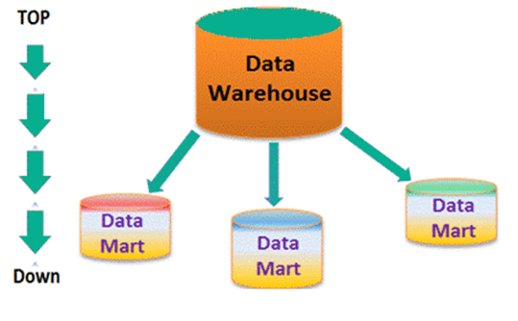
Data Mart

Slide 26
DWH vs DM
Data Warehouse is a large repository of data collected from different sources whereas Data Mart is only subtype of a data warehouse.
Data Warehouse is focused on all departments in an organization whereas Data Mart focuses on a specific group.
Data Warehouse designing process is complicated whereas the Data Mart process is easy to design.
Data Warehouse takes a long time for data handling whereas Data Mart takes a short time for data handling.
Comparing Data Warehouse vs Data Mart, Data Warehouse size range is 100 GB to 1 TB+ whereas Data Mart size is less than 100 GB.
When we differentiate Data Warehouse and Data Mart, Data Warehouse implementation process takes 1 month to 1 year whereas Data Mart takes a few months to complete the implementation process.

Slide 27
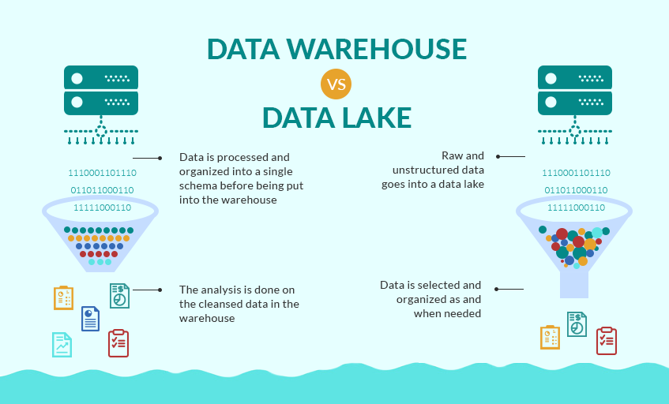
DWH vs DL

Slide 28
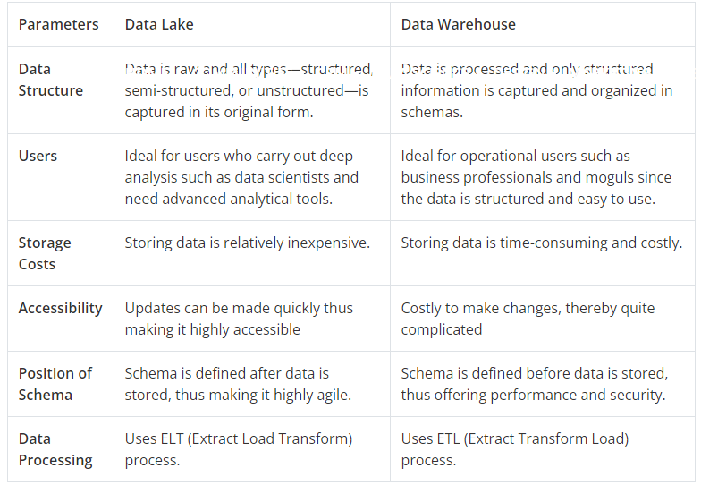

Slide 29
Data Lakes
Data lakes are a fairly new concept and experts have predicted that it might cause the death of data warehouses and data marts.
Although with the increase of unstructured data, data lakes will become quite popular. But you will probably prefer keeping your structured data in a data warehouse.

Slide 30
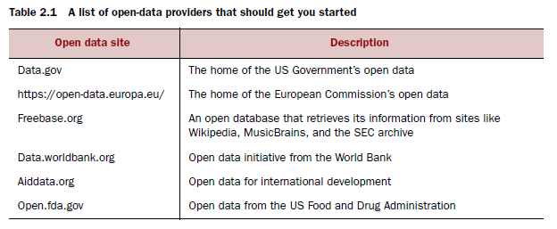
Data Providers

Slide 31
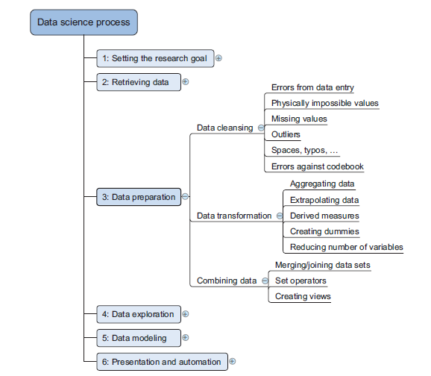
Cleansing, integration and transformation

Slide 32
Cleansing data
Data cleansing is a sub process of the data science process that focuses on removing errors in your data so your data becomes a true and consistent representation of the processes it originates from.
True and consistent representation
interpretation error
inconsistencies

Slide 33
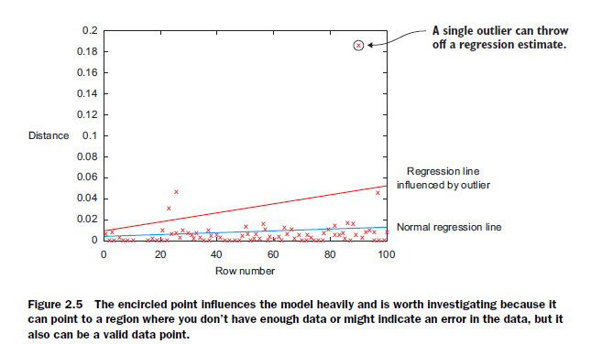
Outliers

Slide 34
Data Entry Errors
Data collection and data entry are error-prone processes.
They often require human intervention, and because humans are only human, they make typos or lose their concentration for a second and introduce an error into the chain. But data collected by machines or computers isn’t free from errors either.
Errors can arise from human sloppiness, whereas others are due to machine or hardware failure.

Slide 35
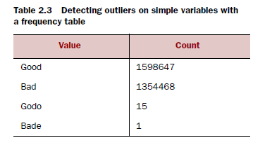
Data Entry Errors

Slide 36
Redundant Whitespaces
Whitespaces tend to be hard to detect but cause errors like other redundant characters would.
Capital letter mismatches are common.
Most programming languages make a distinction between “Brazil” and “brazil”. In this case you can solve the problem by applying a function that returns both strings in lowercase, such as .lower() in Python. “Brazil”.lower() == “brazil”.lower() should result in true.

Slide 37
Impossible values and Sanity checks
Sanity checks are another valuable type of data check.
Sanity checks can be directly expressed with rules:
check = 0 <= age <= 120

Slide 38
Outliers
An outlier is an observation that seems to be distant from other observations or, more specifically, one observation that follows a different logic or generative process than the other observations.
Find outliers ➔ Use a plot or table

Slide 39
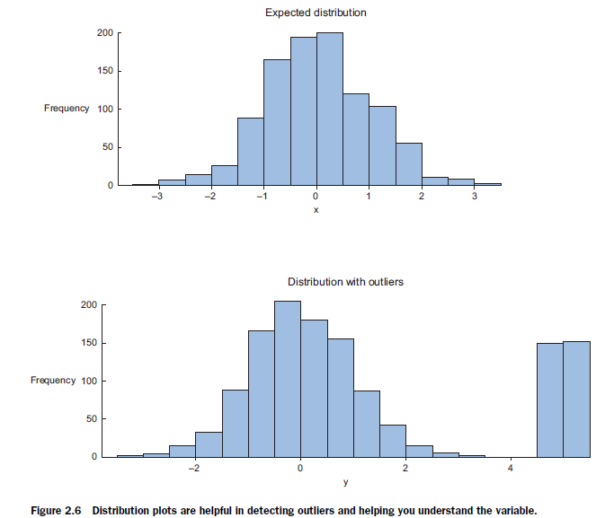
Outliers

Slide 40
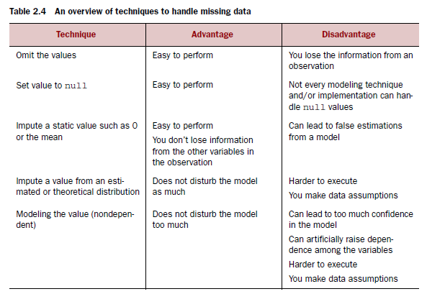
Handle missing data

Slide 41
Deviations from a code book
A code book is a description of your data, a form of metadata.
It contains things such as the number of variables per observation, the number of observations, and what each encoding within a variable means.(For instance “0” equals “negative”, “5” stands for “very positive”.)

Slide 42
Combining data from different data sources
Joining ➔ enriching an observation from one table with information from another table
Appending or Stacking ➔adding the observations of one table to those of another table.

Slide 43
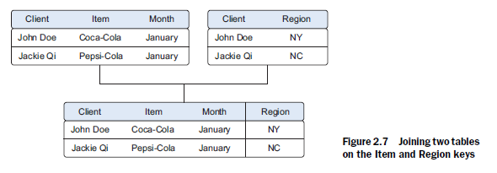
Joining
Joining ➔ focus on enriching a single observation
To join tables, you use variables that represent the same object in both tables, such as a date, a country name, or a Social Security number. These common fields are known as keys.
When these keys also uniquely define the records in the table they are called Primary Keys

Slide 44
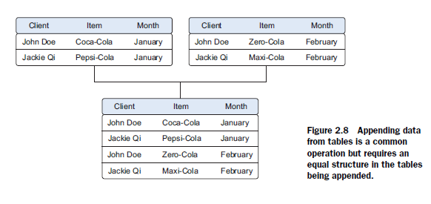
Appending
Appending ➔ effectively adding observations from one table to another table.

Slide 45
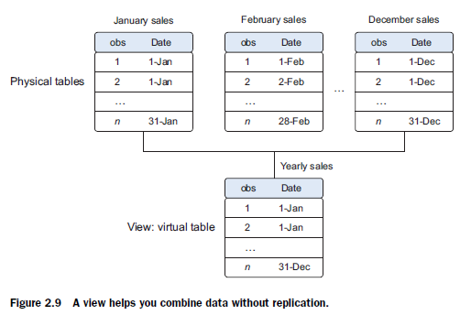
Views
To avoid duplication of data, you virtually combine data with views
Existing ➔ needed more storage space
A view behaves as if you’re working on a table, but this table is nothing but a virtual layer that combines the tables for you.

Slide 46
Views

Slide 47
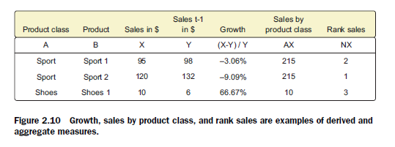
Enriching aggregated measures
Data enrichment can also be done by adding calculated information to the table, such as the total number of sales or what percentage of total stock has been sold in a certain region

Slide 48
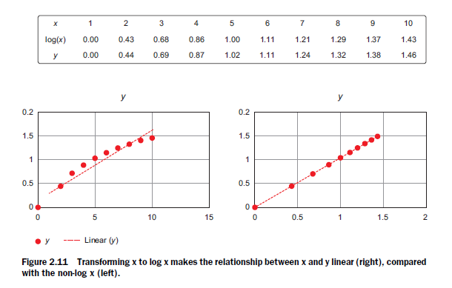
Transforming data
Certain models require their data to be in a certain shape.
Transforming your data so it takes a suitable form for data modeling.

Slide 49
Reducing the number of variables
Too many variables
don’t add new information to the model
model difficult to handle
certain techniques don’t perform well when you overload them with too many input variables
Data scientists use special methods to reduce the number of variables but retain the maximum amount of data.

Slide 50
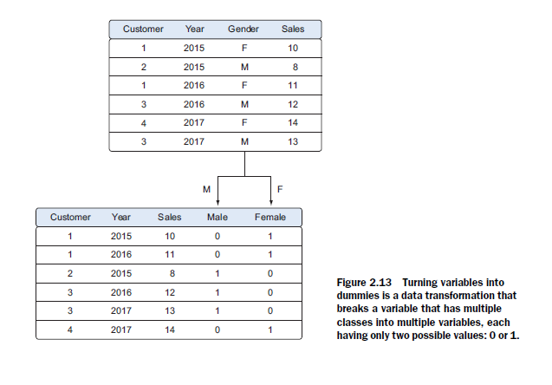
Turning variables into dummies
Dummy variables can only take two values: true(1) or false(0). They’re used to indicate the absence of a categorical effect that may explain the observation.

Slide 51
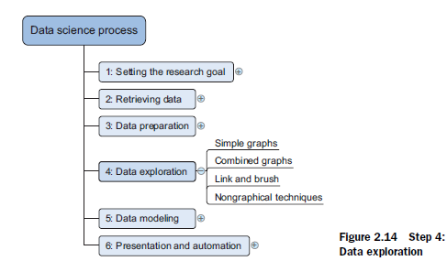
Data Exploration

Slide 52
Data Exploration
Information becomes much easier to grasp when shown in a picture, therefore you mainly use graphical techniques to gain an understanding of your data and the interactions between variables.
Visualization Techniques
Simple graphs
Histograms
Sankey
Network graphs

Slide 53
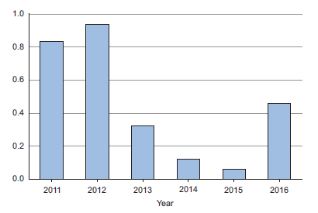
Bar Chart

Slide 54
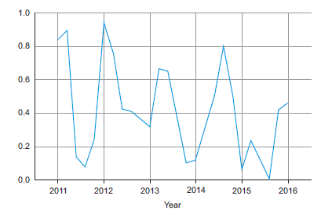
Line Chart

Slide 55
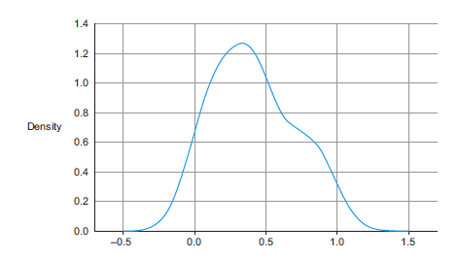
Distribution

Slide 56
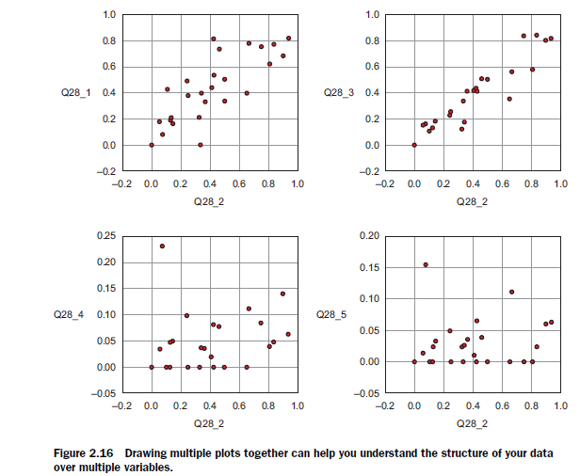
Overlaying

Slide 57
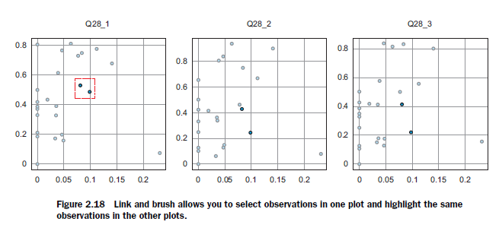
Brushing and Linking

Slide 58
Step 5: build the models

Slide 59
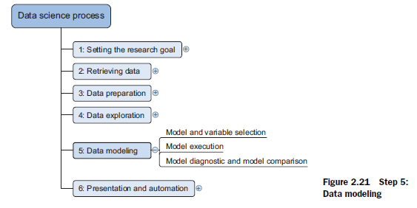
Data modeling

Slide 60
Data modeling
Building a model is an iterative process.
The way you build your model depends on whether you go with classic statistics or the somewhat more recent machine learning school, and the type of technique you want to use.
Models consist of the following main steps:
1 Selection of a modeling technique and variables to enter in the model
2 Execution of the model
3 Diagnosis and model comparison

Slide 61
Model and variable selection
Must the model be moved to a production environment and, if so, would it be easy to implement?
How difficult is the maintenance on the model: how long will it remain relevant if left untouched?
Does the model need to be easy to explain?

Slide 62
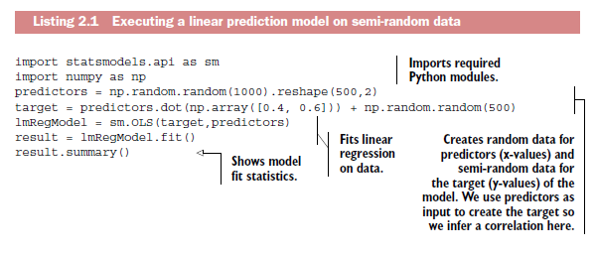
Model execution

Slide 63
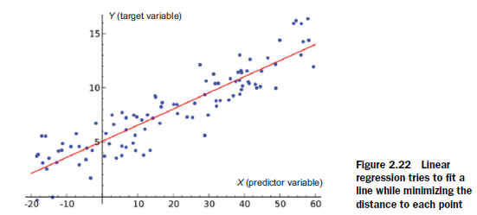
Model execution

Slide 64
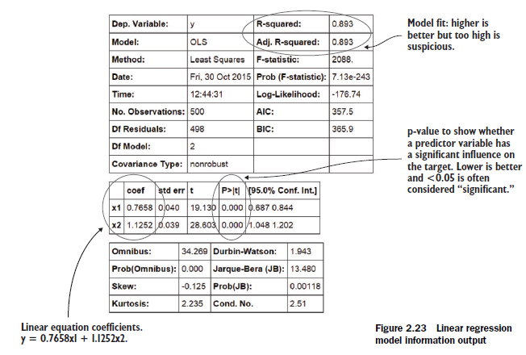
Model execution

Slide 65
Introduction to Python Libraries

Slide 66
NumPy Arrays

Slide 67
NumPy
Numerical Python
General-purpose array-processing package.
High-performance multidimensional array object, and tools for working with these arrays.
Fundamental package for scientific computing with Python.
It is open-source software.

Slide 68
NumPy - Features
A powerful N-dimensional array object
Sophisticated (broadcasting) functions
Tools for integrating C/C++ and Fortran code
Useful linear algebra, Fourier transform, and random number capabilities

Slide 69
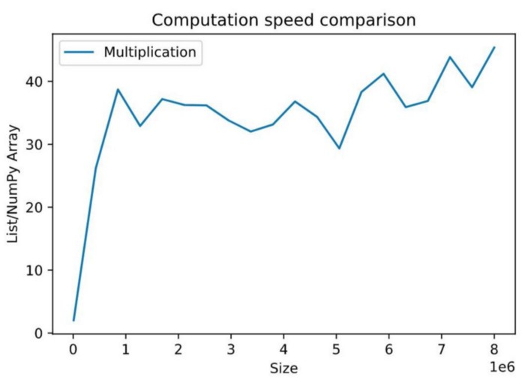
Choosing NumPy over Python list
Notes:
NumPy offers low memory consumption, high speed, and massive lists of functionalities compared to traditional lists. NumPy can divide a task and process them parallelly, which makes them highly efficient. The figure shows the ratio of computation time of list/NumPy array vs. size.
Computation time for the multiplication of two Python lists drastically increases with list size compared to NumPy arrays. Multiplication of two NumPy arrays with 100,000 elements is ~40 times faster than the Python list with the same number of elements. Hence, NumPy is the better solution for arrays with a large number of elements.

Slide 70
Array
An array is a data type used to store multiple values using a single identifier (variable name).
An array contains an ordered collection of data elements where each element is of the same type and can be referenced by its index (position)

Slide 71
Array
Similar to the indexing of lists
Zero-based indexing
[10, 9, 99, 71, 90 ]

Slide 72
NumPy Array
Store lists of numerical data, vectors and matrices
Large set of routines (built-in functions) for creating, manipulating, and transforming NumPy arrays.
NumPy array is officially called ndarray but commonly known as array

Slide 73
Creation of NumPy Arrays from List
First we need to import the NumPy library
import numpy as np

Slide 74
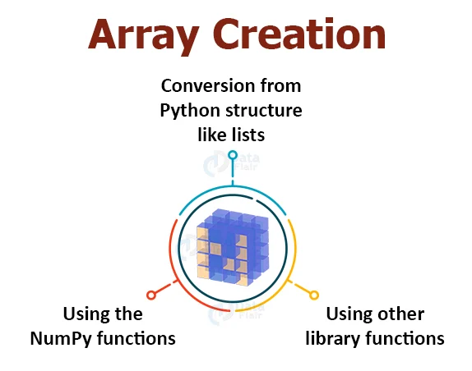
Creation of Arrays

Slide 75
1. Using the NumPy functions
a. Creating one-dimensional array in NumPy
import numpy as np
array=np.arange(20)
array
Output:
array([ 0, 1, 2, 3, 4, 5, 6, 7, 8, 9, 10, 11,12, 13, 14, 15, 16, 17, 18, 19])

Slide 76
1. Using the NumPy functions
a. check the dimensions by using array.shape.
(20, )
Output:
array([ 0 1 2 3 4 5 6 7 8 9 10 1112 13 14,15, 16, 17, 18, 19])

Slide 77
1. Using the NumPy functions
b. Creating two-dimensional arrays in NumPy
array=np.arange(20).reshape(4,5)
Output:
array([[ 0, 1, 2, 3, 4], [ 5, 6, 7, 8, 9], [10, 11, 12, 13, 14] [15, 16, 17, 18, 19]])

Slide 78
1. Using the NumPy functions
c. Using other NumPy functions
np.zeros((2,4))
np.ones((3,6))
np.full((2,2), 3)
Output:
array([[0., 0., 0., 0.], [0., 0., 0., 0.]])
array([[1., 1., 1., 1., 1., 1.], [1., 1., 1., 1., 1., 1.], [1., 1., 1., 1., 1., 1.]])

Slide 79
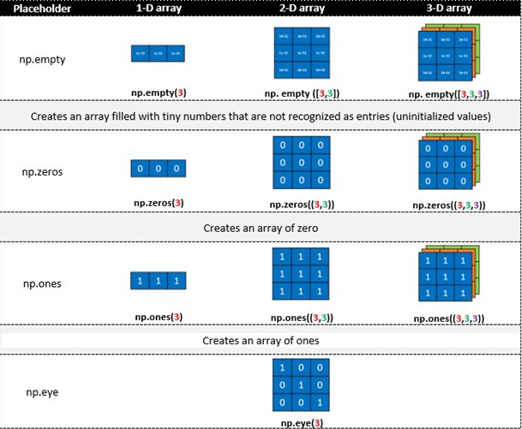
1. Using the NumPy functions

Slide 80
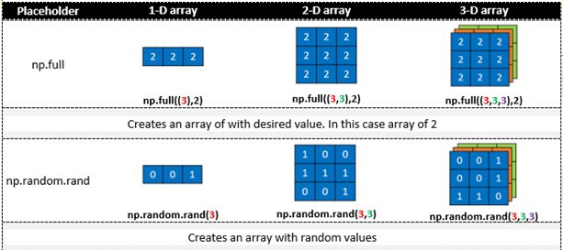
1. Using the NumPy functions

Slide 81
1. Using the NumPy functions
[[0. 0. 0. 0.]
[0. 0. 0. 0.]]
[[1. 1. 1. 1. 1. 1.]
[1. 1. 1. 1. 1. 1.]
[1. 1. 1. 1. 1. 1.]]
[[1.14137702e-316 0.00000000e+000 6.91583610e-310]
[6.91583609e-310 6.91583601e-310 6.91583601e-310]]
[[3 3]
[3 3]]
[[1. 0. 0.]
[0. 1. 0.]
[0. 0. 1.]]
[ 0. 3.33333333 6.66666667 10. ]
c. Using other NumPy functions
import numpy as np
a=np.zeros((2,4))
b=np.ones((3,6))
c=np.empty((2,3))
d=np.full((2,2), 3)
e= np.eye(3,3)
f=np.linspace(0, 10, num=4)
print(a)
print(b)
print(c)
print(d)

Slide 82
1. Using the NumPy functions
Sr No. | Function | Description
1 | empty_like() | Return a new array with the same shape and type
2 | ones_like() | Return an array of ones with the same shape and type.
3 | zeros_like() | Return an array of zeros with the same shape and type
4 | full_like() | Return a full array with the same shape and type
5 | asarray() | Convert the input to an array.
6 | geomspace() | Return evenly spaced numbers on a log scale.
7 | copy() | Returns a copy of the given object

Slide 83
1. Using the NumPy functions
Sr No. | Function | Description
8 | diag() | a diagonal array
9 | frombuffer() | buffer as a 1-D array
10 | fromfile() | Construct an array from text or binary file
11 | bmat() | Build a matrix object from a string, nested sequence, or array
12 | mat() | Interpret the input as a matrix
13 | vander() | Generate a Vandermonde matrix
14 | triu() | Upper triangle of array

Slide 84
1. Using the NumPy functions
Sr No. | Function | Description
15 | tril() | Lower triangle of array
16 | tri() | An array with ones at & below the given diagonal and zeros elsewhere
17 | diagflat() | two-dimensional array with the flattened input as a diagonal
18 | fromfunction() | executing a function over each coordinate
19 | logspace() | Return numbers spaced evenly on a log scale
20 | meshgrid() | Return coordinate matrices from coordinate vectors

Slide 85
2. Conversion from Python structure like lists
import numpy as np
array=np.array([4,5,6]) print(array)
list=[4,5,6]
print(list)
[4 5 6]
[4, 5, 6]

Slide 86
Working with Ndarray
np.ndarray(shape, type)
Creates an array of the given shape with random numbers.
np.array(array_object)
Creates an array of the given shape from the list or tuple.
np.zeros(shape)
Creates an array of the given shape with all zeros.
np.ones(shape)
Creates an array of the given shape with all ones.
np.full(shape,array_object, dtype)
Creates an array of the given shape with complex numbers.
np.arange(range)
Creates an array with the specified range.

Slide 87
NumPy Basic Array Operations
There is a vast range of built-in operations that we can perform on these arrays.
1. ndim – It returns the dimensions of the array. 2. itemsize – It calculates the byte size of each element. 3. dtype – It can determine the data type of the element. 4. reshape – It provides a new view. 5. slicing – It extracts a particular set of elements. 6. linspace – Returns evenly spaced elements. 7. max/min , sum, sqrt 8. ravel – It converts the array into a single line.

Slide 88
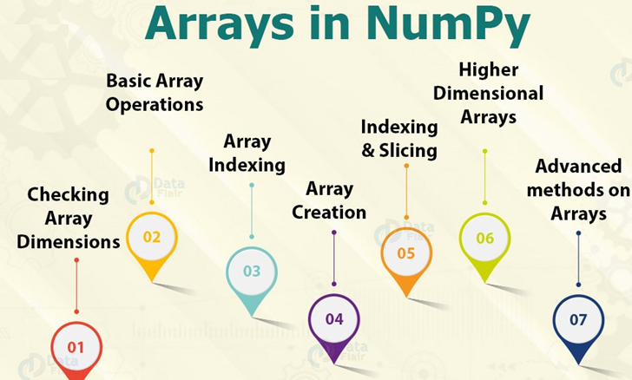
Arrays in NumPy

Slide 89
Checking Array Dimensions in NumPy
import numpy as np
a = np.array(10)
b = np.array([1,1,1,1])
c = np.array([[1, 1, 1], [2,2,2]])
d = np.array([[[1, 1, 1], [2, 2, 2]], [[3, 3, 3], [4, 4, 4]]]) print(a.ndim) #0
print(b.ndim) #1
print(c.ndim) #2
print(d.ndim) #3

Slide 90
Higher Dimensional Arrays in NumPy
import numpy as np
arr = np.array([1, 1, 1, 1, 1], ndmin=10)
print(arr)
print('number of dimensions :', arr.ndim)
[[[[[[[[[[1 1 1 1 1]]]]]]]]]]
number of dimensions : 10

Slide 91
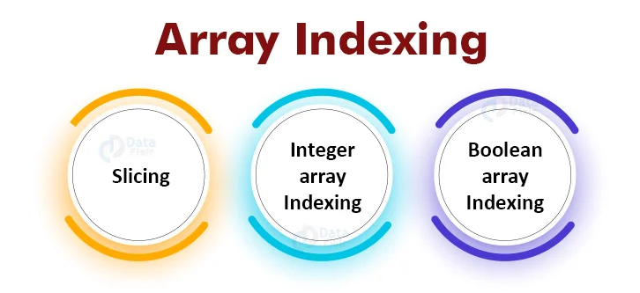
Indexing and Slicing in NumPy

Slide 92
Indexing & Slicing
Indexing
import numpy as np
arr=([1,2,5,6,7])
print(arr[3]) #6
Slicing
import numpy as np
arr=([1,2,5,6,7])
print(arr[2:5]) #[5, 6, 7]

Slide 93
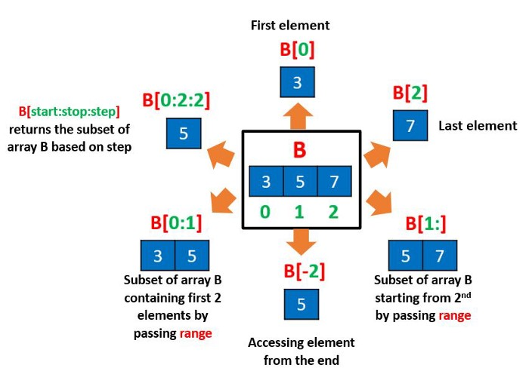
Indexing and Slicing

Slide 94
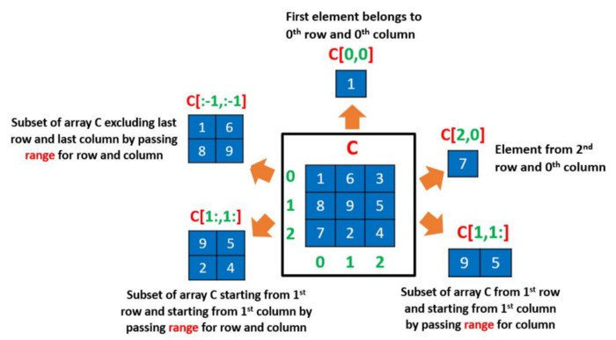
Indexing and Slicing in 2-D

Slide 95
Copying Arrays
Copy from one array to another
Method 1: Using np.empty_like() function
Method 2: Using np.copy() function
Method 3: Using Assignment Operator

Slide 96
Using np.empty_like( )
This function returns a new array with the same shape and type as a given array.
Syntax:
numpy.empty_like(a, dtype = None, order = ‘K’, subok = True)

Slide 97
Using np.empty_like( )
import numpy as np
ary = np.array([13, 99, 100, 34, 65, 11, 66, 81, 632, 44])
print("Original array: ")
# printing the Numpy array
print(ary)
# Creating an empty Numpy array similar to ary
copy = np.empty_like(ary)
# Now assign ary to copy
copy = ary
print("\nCopy of the given array: ")
# printing the copied array
print(copy)

Slide 98
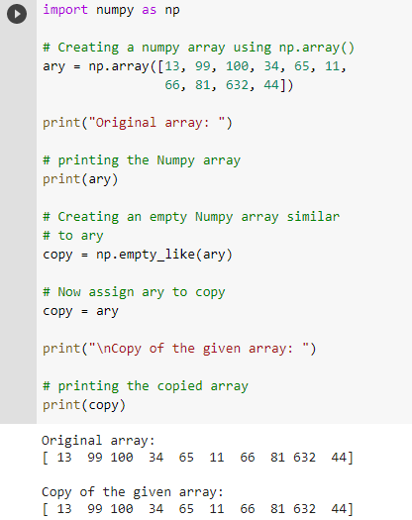
Using np.empty_like( )

Slide 99
Using np.copy() function
This function returns an array copy of the given object. Syntax :
numpy.copy(a, order='K', subok=False)
# importing Numpy package
import numpy as np
org_array = np.array([1.54, 2.99, 3.42, 4.87, 6.94, 8.21, 7.65, 10.50, 77.5])
print("Original array: ")
print(org_array)
# Now copying the org_array to copy_array using np.copy() function
copy_array = np.copy(org_array)
print("\nCopied array: ")
# printing the copied Numpy array
print(copy_array)

Slide 100
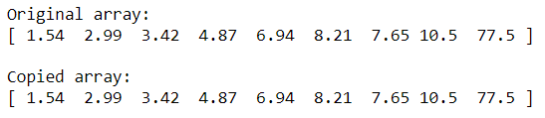
Using np.copy() function
# importing Numpy package
import numpy as np
org_array = np.array([1.54, 2.99, 3.42, 4.87, 6.94, 8.21, 7.65, 10.50, 77.5])
print("Original array: ")
print(org_array)
copy_array = np.copy(org_array)
print("\nCopied array: ")
# printing the copied Numpy array
print(copy_array)

Slide 101
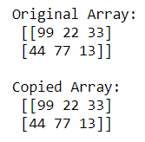
Using Assignment Operator
import numpy as np
org_array = np.array([[99, 22, 33],[44, 77, 66]])
# Copying org_array to copy_array using Assignment operator
copy_array = org_array
# modifying org_array
org_array[1, 2] = 13
# checking if copy_array has remained the same
# printing original array
print('Original Array: \n', org_array)
# printing copied array
print('\nCopied Array: \n', copy_array)

Slide 102
Iterating Arrays
Iterating means going through elements one by one.
As we deal with multi-dimensional arrays in numpy, we can do this using basic for loop of python.
If we iterate on a 1-D array it will go through each element one by one.
Iterate on the elements of the following 1-D array:
import numpy as np arr = np.array([1, 2, 3]) for x in arr: print(x)
Output:
1 2 3

Slide 103
Iterating Arrays
Iterating 2-D Arrays
In a 2-D array it will go through all the rows.
If we iterate on a n-D array it will go through (n-1)th dimension one by one.
import numpy as np arr = np.array([[1, 2, 3], [4, 5, 6]]) for x in arr: print(x)
Output:
[1 2 3] [4 5 6]

Slide 104
Iterating Arrays
To return the actual values, the scalars, we have to iterate the arrays in each dimension.
arr = np.array([[1, 2, 3], [4, 5, 6]])
for x in arr:
for y in x:
print(y)
1 2 3 4 5 6

Slide 105
Iterating Arrays
Iterating 3-D Arrays
In a 3-D array it will go through all the 2-D arrays.
import numpy as np arr = np.array([[[1, 2, 3], [4, 5, 6]], [[7, 8, 9], [10, 11, 12]]]) for x in arr: print(x)
[[1 2 3] [4 5 6]]
[[ 7 8 9] [10 11 12]]

Slide 106
Iterating Arrays
Iterating 3-D Arrays
To return the actual values, the scalars, we have to iterate the arrays in each dimension.
import numpy as np arr = np.array([[[1, 2, 3], [4, 5, 6]], [[7, 8, 9], [10, 11, 12]]]) for x in arr: for y in x: for z in y: print(z)

Slide 107
Iterating Arrays Using nditer()
1 2 3 4 5 6 7 8
1 2 3 4 5 6 7 8
The function nditer() is a helping function that can be used from very basic to very advanced iterations.
Iterating on Each Scalar Element
In basic for loops, iterating through each scalar of an array we need to use n for loops which can be difficult to write for arrays with very high dimensionality.
import numpy as np arr = np.array([[[1, 2], [3, 4]], [[5, 6], [7, 8]]]) for x in np.nditer(arr): print(x)
1
2
3
4
5
6
7
8

Slide 108
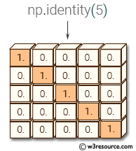
Identity array
The identity array is a square array with ones on the main diagonal.
The identity() function return the identity array.

Slide 109
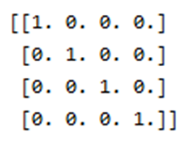
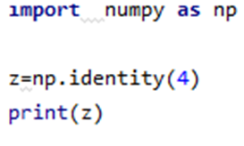
Identity
numpy.identity(n, dtype = None) : Return a identity matrix i.e. a square matrix with ones on the main daignol
Parameters:
n : [int] Dimension n x n of output array
dtype : [optional, float(by Default)] Data type of returned array

Slide 110
Identity array
# 2x2 matrix with 1's on main diagonal
b = geek.identity(2, dtype = float)
print("Matrix b : \n", b)
a = geek.identity(4)
print("\nMatrix a : \n", a)
Output:
Matrix b :
[[ 1. 0.]
[ 0. 1.]]
Matrix a :
[[ 1. 0. 0. 0.]
[ 0. 1. 0. 0.]
[ 0. 0. 1. 0.]
[ 0. 0. 0. 1.]]

Slide 111
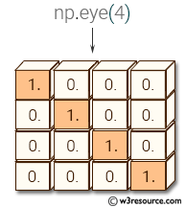
eye( )
numpy.eye(R, C = None, k = 0, dtype = type <‘float’>) : Return a matrix having 1’s on the diagonal and 0’s elsewhere w.r.t. k.
R : Number of rows C : [optional] Number of columns; By default M = N k : [int, optional, 0 by default] Diagonal we require; k>0 means diagonal above main diagonal or vice versa. dtype : [optional, float(by Default)] Data type of returned array.

Slide 112
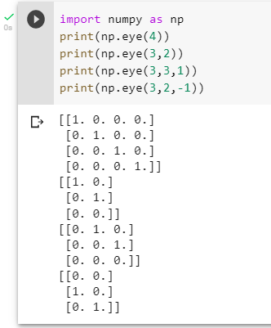
eye( )

Slide 113
Identity( ) vs eye( )
np.identity returns a square matrix (special case of a 2D-array) which is an identity matrix with the main diagonal (i.e. 'k=0') as 1's and the other values as 0's. you can't change the diagonal k here.
np.eye returns a 2D-array, which fills the diagonal, i.e. 'k' which can be set, with 1's and rest with 0's.
So, the main advantage depends on the requirement. If you want an identity matrix, you can go for identity right away, or can call the np.eye leaving the rest to defaults.
But, if you need a 1's and 0's matrix of a particular shape/size or have a control over the diagonal you can go for eye method.

Slide 114
Identity( ) vs eye( )
import numpy as np
print(np.eye(3,5,1))
print(np.eye(8,4,0))
print(np.eye(8,4,-1))
print(np.eye(8,4,-2))
Print(np.identity(4)

Slide 115
Shape of an Array
import numpy as np arr = np.array([[1, 2, 3, 4], [5, 6, 7, 8]]) print(arr.shape)
Output: (2,4)

Slide 116
Reshaping arrays
Reshaping means changing the shape of an array.
The shape of an array is the number of elements in each dimension.
By reshaping we can add or remove dimensions or change number of elements in each dimension.

Slide 117
Reshape From 1-D to 2-D
import numpy as np arr = np.array([1, 2, 3, 4, 5, 6, 7, 8, 9, 10, 11, 12]) newarr = arr.reshape(4, 3) print(newarr)
Output:
[[ 1 2 3]
[ 4 5 6]
[ 7 8 9]
[10 11 12]]

Slide 118
Reshape From 1-D to 3-D
The outermost dimension will have 2 arrays that contains 3 arrays, each with 2 elements
import numpy as np arr = np.array([1, 2, 3, 4, 5, 6, 7, 8, 9, 10, 11, 12]) newarr = arr.reshape(2, 3, 2) print(newarr)
Output:
[[[ 1 2]
[ 3 4]
[ 5 6]]
[[ 7 8]
[ 9 10]
[11 12]]]

Slide 119
Can we Reshape into any Shape?
Yes, as long as the elements required for reshaping are equal in both shapes.
We can reshape an 8 elements 1D array into 4 elements in 2 rows 2D array but we cannot reshape it into a 3 elements 3 rows 2D array as that would require 3x3 = 9 elements.
import numpy as np arr = np.array([1, 2, 3, 4, 5, 6, 7, 8]) newarr = arr.reshape(3, 3) print(newarr)
Traceback (most recent call last): File "demo_numpy_array_reshape_error.py", line 5, in <module> ValueError: cannot reshape array of size 8 into shape (3,3)

Slide 120
Flattening the arrays
Flattening array means converting a multidimensional array into a 1D array.
import numpy as np arr = np.array([[1, 2, 3], [4, 5, 6]]) newarr = arr.reshape(-1) print(newarr)
Output: [1 2 3 4 5 6]
There are a lot of functions for changing the shapes of arrays in numpy flatten, ravel and also for rearranging the elements rot90, flip, fliplr, flipud etc. These fall under Intermediate to Advanced section of numpy.

Slide 121
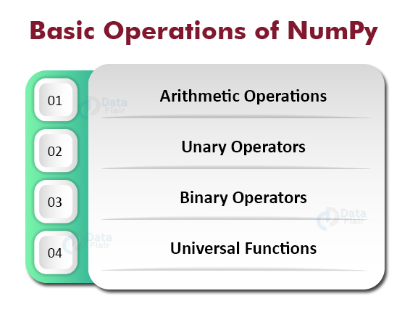
Operations on NumPy

Slide 122
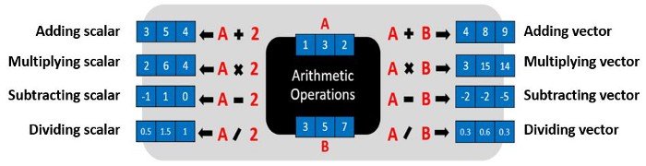
1.NumPy Arithmetic Operations

Slide 123
1.NumPy Arithmetic Operations
import numpy as np
a = np.array([1, 2, 3, 4])
# add 5 to every element
print ( a+5)
# subtract 2 from each element
print ( a-2)
# multiply each element by 5
print (a*10)
# divide each element by 2
print ( a/2)
[6 7 8 9]
[-1 0 1 2]
[10 20 30 40]
[0.5 1. 1.5 2. ]

Slide 124
2. NumPy Unary Operators
import numpy as np
arr = np.array([[1,5, 12], [2,32, 20], [3, 40, 13]]) print(arr.max(axis = 1))
print(arr.max(axis = 0))
print (arr.min(axis = 0))
print(arr.min(axis = 1))
print (arr.sum( ))
print ( arr.sum(axis=0))
print( arr.sum(axis=1))
[12 32 40]
[ 3 40 20]
[ 1 5 12]
[1 2 3]
128
[6 77 45]
[18 54 56]

Slide 125
3. NumPy Binary Operators
import numpy as np
a = np.array([[1, 2], [3, 4]])
b = np.array([[4, 3], [2, 1]])
print (a + b)
print (a*b)
[[5 5]
[5 5]]
[[4 6]
[6 4]]

Slide 126
NumPy Universal Functions
import numpy as np
a = np.array([0, np.pi/2, np.pi])
print ( np.sin(a))
a = np.array([0, 1, 2, 3])
print ( np.exp(a))
print ( np.sqrt(a))
[0.0000000e+00 1.0000000e+00 1.2246468e-16]
[ 1. 2.71828183 7.3890561 20.08553692]
[0. 1. 1.41421356 1.73205081]

Slide 127

Arithmetic Operators & Functions

Slide 128

Mathematical Functions

Slide 129
NumPy functions
import numpy as np
a = np.array([7,3,4,5,1])
b = np.array([3,4,5,6,7])
np.add(a, b) #([ 10, 7, 9, 11, 8])
np.subtract(a,b) #[ 4,-1,-1,-1,-6] np.multiply(a, b) #[21, 12, 20, 30, 7]
np.divide(a, b) #[2.33333333, 0.75 , 0.8 , 0.83333333, 0.14285714]
np.remainder(a,b) #[1, 3, 4, 5, 1]
np.mod(a,b) #[1, 3, 4, 5, 1]
np.power(a,b) #[ 343, 81, 1024, 15625, 1]
np.reciprocal(a) #[0, 0, 0, 0, 1]

Slide 130
NumPy Add Operator
import numpy as np
a = np.array([10,20,100,200,500])
b = np.array([3,4,5,6,7])
print(a+b) #[ 13 24 105 206 507] print(a-b)
print(a*b)
print(a/b)

Slide 131

Types of Array

Slide 132

Creating a 1-D Array

Slide 133

Creating a 1-D Array

Slide 134

Creation of a multidimensional array(ndarray)

Slide 135

Creation of a multidimensional array(ndarray)

Slide 136

Creation of a multidimensional array(ndarray)

Slide 137

Program to illustrate Indexing in Ndarrays

Slide 138

Program to illustrate Indexing in Ndarrays

Slide 139

Program to illustrate Indexing in a 3D array

Slide 140

Program to illustrate Indexing in a 3D array

Slide 141

Operations on Ndarray

Slide 142

Operations on Ndarray

Slide 143

Add two 1d arrays element-wise

Slide 144
Add two 1d arrays element-wise
import numpy as np
# create numpy arrays x1 and x2
x1 = np.array([1, 3, 0, 7])
x2 = np.array([2, 0, 1, 1])
# elementwise sum with np.add()
x3 = np.add(x1, x2)
# display the arrays
print("x1:", x1)
print("x2:", x2)
print("x3:", x3)

Slide 145
Add two 1d arrays element-wise
import numpy as np
# create numpy arrays x1 and x2
x1 = np.array([1, 2, 0, 3])
x2 = np.array([4, 1,2, 2])
# elementwise sum with np.add()
x3 = np.add(x1, x2)
# display the arrays
print("x1:", x1)
print("x2:", x2)
print("x3:", x3)
x3 = x1 + x2
# display the arrays
print("x1:", x1)
print("x2:", x2)
print("x3:", x3)
x1: [1 2 0 3]
x2: [4 1 2 2]
x3: [5 3 2 5]

Slide 146
Add two 2d arrays elementwise
# create 2d arrays x1 and x2
x1 = np.array([[1, 0, 1], [2, 1, 1], [3, 0, 3]])
x2 = np.array([[2, 2, 0], [1, 0, 1], [0, 1, 0]])
# elementwise sum with np.add()
x3 = np.add(x1, x2)
# display the arrays print("x1:\n", x1)
print("x2:\n", x2)
print("x3:\n", x3)
x1:
[[1 0 1]
[2 1 1]
[3 0 3]]
x2:
[[2 2 0]
[1 0 1]
[0 1 0]]
x3:
[[3 2 1]
[3 1 2]
[3 1 3]]

Slide 147
Add more than two arrays elementwise
# create numpy arrays x1, x2, and x3
x1 = np.array([1, 3, 0, 7])
x2 = np.array([2, 0, 1, 1])
x3 = np.array([0, 1, 3, 1])
# elementwise sum with +
x4 = x1+x2+x3
# display the arrays
print("x1:", x1)
print("x2:", x2)
print("x3:", x3)
print("x4:", x4)
x1: [1 3 0 7]
x2: [2 0 1 1]
x3: [0 1 3 1]
x4: [3 4 4 9]

Slide 148
NumPy Array attributes
1. ndarray.flags- It provides information about memory layout 2. ndarray.shape- Provides array dimensions 3. ndarray.strides- Determines step size while traversing the arrays 4. ndarray.ndim- Number of array dimensions 5. ndarray.data- Points the starting position of array 6. ndarray.size- Number of array elements 7. ndarray.itemsize- Size of individual array elements in bytes 8. ndarray.base- Provides the base object, if it is a view 9. ndarray.nbytes- Provides the total bytes consumed by the array 10. ndarray.T- It gives the array transpose 11. ndarray.real- Separates the real part 12. ndarray.imag- Separates the imaginary

Slide 149
NumPy Array attributes
1. ndarray.flags- It provides information about memory layout 2. ndarray.shape- Provides array dimensions 3. ndarray.strides- Determines step size while traversing the arrays 4. ndarray.ndim- Number of array dimensions 5. ndarray.data- Points the starting position of array 6. ndarray.size- Number of array elements 7. ndarray.itemsize- Size of individual array elements in bytes 8. ndarray.base- Provides the base object, if it is a view 9. ndarray.nbytes- Provides the total bytes consumed by the array 10. ndarray.T- It gives the array transpose 11. ndarray.real- Separates the real part 12. ndarray.imag- Separates the imaginary

Slide 150


Slide 151
Join, split, search and sort

Slide 152
Joining
Joining means putting contents of two or more arrays in a single array.
In SQL we join tables based on a key, whereas in NumPy we join arrays by axes.
We pass a sequence of arrays that we want to join to the concatenate() function, along with the axis. If axis is not explicitly passed, it is taken as 0.

Slide 153

Join

Slide 154
Join two arrays
import numpy as np arr1 = np.array([1, 2, 3]) arr2 = np.array([4, 5, 6]) arr = np.concatenate((arr1, arr2)) print(arr)
Output:[1 2 3 4 5 6]

Slide 155
Join two 2-D arrays along rows (axis=1)
import numpy as np arr1 = np.array([[1, 2], [3, 4]]) arr2 = np.array([[5, 6], [7, 8]]) arr = np.concatenate((arr1, arr2), axis=1) print(arr)
Output:[[1 2 5 6] [3 4 7 8]]

Slide 156
stack( )
Stacking is same as concatenation, the only difference is that stacking is done along a new axis.
We can concatenate two 1-D arrays along the second axis which would result in putting them one over the other, ie. stacking.
We pass a sequence of arrays that we want to join to the stack() method along with the axis. If axis is not explicitly passed it is taken as 0.

Slide 157
stack( )
import numpy as np arr1 = np.array([1, 2, 3]) arr2 = np.array([4, 5, 6]) arr = np.stack((arr1, arr2), axis=1) print(arr)
Output: [[1 4] [2 5] [3 6]]

Slide 158

hstack( ) - Stacking Along Rows
NumPy provides a helper function: hstack() to stack along rows.
import numpy as np arr1 = np.array([1, 2, 3]) arr2 = np.array([4, 5, 6]) arr = np.hstack((arr1, arr2)) print(arr)
Output: [1 2 3 4 5 6]

Slide 159

vstack( ) - Stacking Along Columns
NumPy provides a helper function: vstack() to stack along columns.
import numpy as np arr1 = np.array([1, 2, 3]) arr2 = np.array([4, 5, 6]) arr = np.vstack((arr1, arr2)) print(arr)
Output: [[1 2 3] [4 5 6]]

Slide 160

Split

Slide 161
Splitting
Splitting is reverse operation of Joining.
Joining merges multiple arrays into one and Splitting breaks one array into multiple.

Slide 162


Split
split( )
array_split( )

Slide 163


Split
hsplit( )
vsplit( )

Slide 164
Splitting
We use array_split() for splitting arrays, we pass it the array we want to split and the number of splits.
Note: The return value is an array containing three arrays.
If the array has less elements than required, it will adjust from the end accordingly.
Note: We also have the method split() available but it will not adjust the elements when elements are less in source array for splitting like in example above, array_split() worked properly but split() would fail.

Slide 165
array_split( )
import numpy as np arr = np.array([1, 2, 3, 4, 5, 6]) newarr = np.array_split(arr, 3) print(newarr)
Output:
[array([1, 2]), array([3, 4]), array([5, 6])]

Slide 166
split( )
import numpy as np arr = np.array([1, 2, 3, 4, 5, 6]) newarr = np.split(arr, 3) print(newarr)
Output:
[array([1, 2]), array([3, 4]), array([5, 6])]

Slide 167
array_split( )
import numpy as np
arr = np.array([1, 2, 3, 4, 5, 6])
newarr = np.array_split(arr, 4)
print(newarr)
Output:[array([1, 2]), array([3, 4]), array([5]), array([6])]

Slide 168
split( )
import numpy as np arr = np.array([1, 2, 3, 4, 5, 6]) newarr = np.split(arr, 4) print(newarr)
Output:
Error

Slide 169
Split Into Arrays
The return value of the array_split() method is an array containing each of the split as an array.
import numpy as np arr = np.array([1, 2, 3, 4, 5, 6]) newarr = np.array_split(arr, 3) print(newarr[0]) print(newarr[1]) print(newarr[2])
Output:[1 2] [3 4] [5 6]

Slide 170
Splitting 2-D Arrays
Use the same syntax when splitting 2-D arrays.
Use the array_split() method, pass in the array you want to split and the number of splits you want to do.
import numpy as np arr = np.array([[1, 2], [3, 4], [5, 6], [7, 8], [9, 10], [11, 12]]) newarr = np.array_split(arr, 3) print(newarr)
Output:[array([[1, 2], [3, 4]]), array([[5, 6], [7, 8]]), array([[ 9, 10], [11, 12]])]

Slide 171
hsplit( ) and vsplit( )
The hsplit() function is used to split an array into multiple sub-arrays horizontally (column-wise).
hsplit is equivalent to split with axis=1, the array is always split along the second axis regardless of the array dimension.
The vsplit() function is used to split an array into multiple sub-arrays vertically (row-wise).
Note: vsplit is equivalent to split with axis=0 (default), the array is always split along the first axis regardless of the array dimension.

Slide 172
hsplit
import numpy as np arr = np.array([[1, 2, 3], [4, 5, 6], [7, 8, 9], [10, 11, 12], [13, 14, 15], [16, 17, 18]]) newarr = np.hsplit(arr, 3) print(newarr)
[array([[ 1],
[ 4],
[ 7],
[10],
[13],
[16]]), array([[ 2],
[ 5],
[ 8],
[11],
[14],
[17]]), array([[ 3],
[ 6],
[ 9],
[12],
[15],
[18]])]

Slide 173
vsplit
import numpy as np
arr = np.array([[1, 2, 3], [4, 5, 6], [7, 8, 9], [10, 11, 12], [13, 14, 15], [16, 17, 18]])
newarr = np.vsplit(arr, 3)
print(newarr)
[array([[1, 2, 3], [4, 5, 6]]), array([[ 7, 8, 9], [10, 11, 12]]), array([[13, 14, 15], [16, 17, 18]])]

Slide 174
Searching
You can search an array for a certain value, and return the indexes that get a match.
To search an array, use the where() method.
Find the indexes where the value is 4
import numpy as np arr = np.array([1, 2, 3, 4, 5, 4, 4]) x = np.where(arr == 4) print(x)
Output:(array([3, 5, 6]),)

Slide 175
Sorting
Sorting means putting elements in an ordered sequence.
Ordered sequence is any sequence that has an order corresponding to elements, like numeric or alphabetical, ascending or descending.
The NumPy ndarray object has a function called sort(), that will sort a specified array.
Note: This method returns a copy of the array, leaving the original array unchanged.
import numpy as np arr = np.array([3, 2, 0, 1]) print(np.sort(arr))
Output:[0 1 2 3]

Slide 176

Search

Slide 177
Array shape manipulation

Slide 178

Reshaping Array

Slide 179

List and Array

Slide 180
Linear Algebra with Numpy

Slide 181
Linear Algebra Module
The Linear Algebra module of NumPy offers various methods to apply linear algebra on any numpy array. One can find:
rank, determinant, trace, etc. of an array.
eigen values of matrices
matrix and vector products (dot, inner, outer,etc. product), matrix exponentiation
solve linear or tensor equations and much more!

Slide 182
Example
# Importing numpy as np
import numpy as np
A = np.array([[6, 1, 1],
[4, -2, 5],
[2, 8, 7]])
# Rank of a matrix
print("Rank of A:", np.linalg.matrix_rank(A))
# Trace of matrix A
print("\nTrace of A:", np.trace(A))
# Determinant of a matrix
print("\nDeterminant of A:", np.linalg.det(A))
# Inverse of matrix A
print("\nInverse of A:\n", np.linalg.inv(A))
print("\nMatrix A raised to power 3:\n",
np.linalg.matrix_power(A, 3))

Slide 183
Output
Rank of A: 3
Trace of A: 11
Determinant of A: -306.0
Inverse of A:
[[ 0.17647059 -0.00326797 -0.02287582]
[ 0.05882353 -0.13071895 0.08496732]
[-0.11764706 0.1503268 0.05228758]]
Matrix A raised to power 3:
[[336 162 228]
[406 162 469]
[698 702 905]]

Slide 184
Eigen values and Eigen vectors

Slide 185
Eigen values and vectors
The Python Numpy linear algebra package can find the eigenvalues and eigenvectors of a matrix.
We calculate the eigenvalues and eigenvectors of the matrix
import numpy as np
from numpy import linalg as LA
A = np.array([[1,2,3],[3,2,1],[1,0,-1]])
w, v = LA.eig(A)
print(w)
[ 4.31662479e+00 -2.31662479e+00 3.43699053e-17] print(v)
[[ 0.58428153 0.73595785 0.40824829] [ 0.80407569 -0.38198836 -0.81649658] [ 0.10989708 -0.55897311 0.40824829]]

Slide 186
Eigen values and vectors
The numpy.linalg.eig function returns a tuple consisting of a vector and an array
The vector (here w) contains the eigenvalues.
The array (here v) contains the corresponding eigenvectors, one eigenvector per column.
The eigenvalue w[0] goes with the 0th column of v. The eigenvalue w[1] goes with column 1, etc.
To extract the ith column vector, we use
u = v[:,i]

Slide 187
Eigen values
# importing numpy library
import numpy as np
# create numpy 2d-array
m = np.array([[1, 2], [2, 3]])
print("Printing the Original square array:\n",m)
# finding eigenvalues and eigenvectors
w, v = np.linalg.eig(m)
# printing eigen values
print("Printing the Eigen values of the given square array:\n", w)
# printing eigen vectors
print("Printing Right eigenvectors of the given square array:\n“,v)

Slide 188
Eigen values
Printing the Original square array:
[[1 2]
[2 3]]
Printing the Eigen values of the given square array:
[-0.23606798 4.23606798]
Printing Right eigenvectors of the given square array:
[[-0.85065081 -0.52573111]
[ 0.52573111 -0.85065081]]

Slide 189
Eigen vectors
# importing numpy library
import numpy as np
# create numpy 2d-array
m = np.array([[1, 2, 3],[2, 3, 4],[4, 5, 6]])
print("Printing the Original square array:\n",m)
# finding eigenvalues and eigenvectors
w, v = np.linalg.eig(m)
# printing eigen values
print("Printing the Eigen values of the given square array:\n",w)
# printing eigen vectors
print("Printing Right eigenvectors of the given square array:\n",v)

Slide 190
Eigen vectors
Printing the Original square array:
[[1 2 3]
[2 3 4]
[4 5 6]]
Printing the Eigen values of the given square array:
[ 1.08309519e+01 -8.30951895e-01 1.01486082e-16]
Printing Right eigenvectors of the given square array:
[[ 0.34416959 0.72770285 0.40824829]
[ 0.49532111 0.27580256 -0.81649658]
[ 0.79762415 -0.62799801 0.40824829]]

Slide 191
Numpy Random Data Distribution, Normal, Exponential, Binomial, Poisson, Uniform and ChiSquare distributions.

Slide 192
Random
Random number does NOT mean a different number every time. Random means something that can not be predicted logically.
Pseudorandom
Computers work on programs, and programs are definitive set of instructions. So it means there must be some algorithm to generate a random number as well.
If there is a program to generate random number it can be predicted, thus it is not truly random.
Random numbers generated through a generation algorithm are called pseudo random.

Slide 193
Random
Random number does NOT mean a different number every time. Random means something that can not be predicted logically.
Truerandom
In order to generate a truly random number on our computers we need to get the random data from some outside source. This outside source is generally our keystrokes, mouse movements, data on network etc.
We do not need truly random numbers, unless its related to security (e.g. encryption keys) or the basis of application is the randomness (e.g. Digital roulette wheels).

Slide 194
Generate Random number
from numpy import random x = random.randint(100) print(x)
Output:45

Slide 195
Generate Random Float
from numpy import random x = random.rand() print(x)
Output:0.20589891226659818

Slide 196
Generate Random Array
In NumPy we work with arrays, and you can use the two methods from the above examples to make random arrays.
Integers
The randint() method takes a size parameter where you can specify the shape of an array.
from numpy import random x=random.randint(100, size=(5)) print(x)
Output:[61 66 32 13 16]

Slide 197
Data Distribution
Data Distribution is a list of all possible values, and how often each value occurs.
Such lists are important when working with statistics and data science.
The random module offer methods that returns randomly generated data distributions.

Slide 198
Random Distribution
A random distribution is a set of random numbers that follow a certain probability density function.
Probability Density Function: A function that describes a continuous probability. i.e. probability of all values in an array.
We can generate random numbers based on defined probabilities using the choice() method of the random module.
The choice() method allows us to specify the probability for each value.
The probability is set by a number between 0 and 1, where 0 means that the value will never occur and 1 means that the value will always occur.

Slide 199
Example
Generate a 1-D array containing 100 values, where each value has to be 3, 5, 7 or 9.
The probability for the value to be 3 is set to be 0.1
The probability for the value to be 5 is set to be 0.3
The probability for the value to be 7 is set to be 0.6
The probability for the value to be 9 is set to be 0
from numpy import random
x = random.choice([3, 5, 7, 9], p=[0.1, 0.3, 0.6, 0.0], size=(100))
print(x)

Slide 200
Example
[3 7 5 7 7 7 5 7 3 7 3 7 7 7 7 5 7 5 7 7 7 7 7 5 3 7 5 7 7 7 3 5 3 7 5 7 7 5 7 5 7 5 7 7 5 7 7 3 5 3 5 7 7 5 7 7 7 7 5 7 5 3 5 5 7 7 7 3 7 7 7 7 5 7 7 5 7 7 7 7 7 7 5 5 3 5 5 7 5 5 7 7 5 3 3 7 7 5 7 7]

Slide 201
Example
You can return arrays of any shape and size by specifying the shape in the size parameter.
Same example as above, but return a 2-D array with 3 rows, each containing 5 values.
from numpy import random x = random.choice([3, 5, 7, 9], p=[0.1, 0.3, 0.6, 0.0], size=(3, 5)) print(x)
[[7 7 7 7 7]
[5 3 5 7 5]
[5 7 5 7 5]]

Slide 202
Normal Distribution
The Normal Distribution is one of the most important distributions.
It is also called the Gaussian Distribution after the German mathematician Carl Friedrich Gauss.
It fits the probability distribution of many events, eg. IQ Scores, Heartbeat etc.
Use the random.normal() method to get a Normal Data Distribution.
It has three parameters:
loc - (Mean) where the peak of the bell exists.
scale - (Standard Deviation) how flat the graph distribution should be.
size - The shape of the returned array.

Slide 203
Normal Distribution
from numpy import random x = random.normal(size=(2, 3)) print(x)
Output:
Run1:
[[ 0.15001821 -1.31355388 -1.35020654] [-1.31067087 -0.48537757 -0.02052509]]
Run2:
[[-2.0610908 -0.3081812 0.99886608] [ 0.56001902 0.38363428 -0.07954767]]

Slide 204

Visualization of Normal Distribution
from numpy import random import matplotlib.pyplot as plt import seaborn as sns sns.distplot(random.normal(size=1000), hist=False) plt.show()

Slide 205
Exponential Distribution
Exponential distribution is used for describing time till next event e.g. failure/success etc.
It has two parameters:
scale - inverse of rate ( see lam in poisson distribution ) defaults to 1.0.
size - The shape of the returned array.

Slide 206
Exponential Distribution
Time Between Customers
The number of minutes between customers who enter a certain shop can be modeled by the exponential distribution.
For example, suppose a new customer enters a shop every two minutes, on average. After a customer arrives, find the probability that a new customer arrives in less than one minute.
To solve this, we can start by knowing that the average time between customers is two minutes. Thus, the rate can be calculated as:
λ = 1/μ
λ = 1/2
λ = 0.5
We can plug in λ = 0.5 and x = 1 to the formula for the CDF:
P(X ≤ x) = 1 – e^{-λx}
P(X ≤ 1) = 1 – e^{-0.5(1)}
P(X ≤ 1) = 0.3935
The probability that we’ll have to wait less than one minute for the next customer to arrive is 0.3935.

Slide 207
Exponential Distribution
Draw out a sample for exponential distribution with 2.0 scale with 2x3 size:
from numpy import random x = random.exponential(scale=2, size=(2, 3)) print(x)
Output:[[0.16401759 5.71219287 1.20149124] [2.51527074 2.13596927 1.04229153]]

Slide 208
Binomial Distribution
A binomial distribution can be thought of as simply the probability of a SUCCESS or FAILURE outcome in an experiment or survey that is repeated multiple times.
The binomial is a type of distribution that has two possible outcomes (the prefix “bi” means two, or twice).
For example, a coin toss has only two possible outcomes: heads or tails and taking a test could have two possible outcomes: pass or fail.

Slide 209

Binomial Distribution

Slide 210
Example
For example, let’s suppose you wanted to know the probability of getting a 1 on a die roll. if you were to roll a die 20 times, the probability of rolling a one on any throw is 1/6. Roll twenty times and you have a binomial distribution of (n=20, p=1/6). SUCCESS would be “roll a one” and FAILURE would be “roll anything else.”
If the outcome in question was the probability of the die landing on an even number, the binomial distribution would then become (n=20, p=1/2). That’s because your probability of throwing an even number is one half.

Slide 211
Binomial Distribution
Binomial Distribution is a Discrete Distribution.
It describes the outcome of binary scenarios, e.g. toss of a coin, it will either be head or tails.
It has three parameters:
n - number of trials.
p - probability of occurence of each trial (e.g. for toss of a coin 0.5 each).
size - The shape of the returned array.
Discrete Distribution:The distribution is defined at separate set of events, e.g. a coin toss's result is discrete as it can be only head or tails whereas height of people is continuous as it can be 170, 170.1, 170.11

Slide 212
Binomial Distribution
Given 10 trials for coin toss generate 10 data points:
from numpy import random x = random.binomial(n=10, p=0.5, size=10) print(x)
Output:[5 7 6 5 4 7 5 4 6 5]
[5 3 6 4 3 3 3 5 5 5]

Slide 213

Visualization of Binomial Distribution
from numpy import random import matplotlib.pyplot as plt import seaborn as sns sns.distplot(random.binomial(n=10, p=0.5, size=1000), hist=True, kde=False) plt.show()

Slide 214

Poisson Distribution
Poisson Distribution is a Discrete Distribution.
It estimates how many times an event can happen in a specified time. e.g. If someone eats twice a day what is probability he will eat thrice?
It has two parameters:
lam - rate or known number of occurences e.g. 2 for above problem.
size - The shape of the returned array.

Slide 215

Poisson Distribution

Slide 216

Poisson Distribution

Slide 217

Poisson Distribution

Slide 218

Poisson Distribution

Slide 219

Poisson Distribution

Slide 220

Poisson Distribution

Slide 221

Poisson Distribution

Slide 222

Poisson Distribution

Slide 223

Poisson Distribution

Slide 224

Poisson Distribution

Slide 225

Poisson Distribution

Slide 226

Poisson Distribution

Slide 227

Poisson Distribution

Slide 228
Poisson Distribution
Poisson Distribution is a Discrete Distribution.
It estimates how many times an event can happen in a specified time. e.g. If someone eats twice a day what is probability he will eat thrice?
It has two parameters:
lam - rate or known number of occurences e.g. 2 for above problem.
size - The shape of the returned array.

Slide 229
Poisson Distribution
Generate a random 1x10 distribution for occurence 2:
from numpy import random x = random.poisson(lam=2, size=10) print(x)

Slide 230
Uniform Distribution
Used to describe probability where every event has equal chances of occurring.
E.g. Generation of random numbers.
It has three parameters:
a - lower bound - default 0 .0.
b - upper bound - default 1.0.
size - The shape of the returned array.

Slide 231
Uniform Distribution
Create a 2x3 uniform distribution sample:
from numpy import random x = random.uniform(size=(2, 3)) print(x)
Output:[[0.21295952 0.57512648 0.39384297] [0.7543237 0.80233051 0.53264002]]

Slide 232
Chi Square Distribution
Chi Square distribution is used as a basis to verify the hypothesis.
It has two parameters:
df - (degree of freedom).
size - The shape of the returned array.

Slide 233
Chi Square Distribution
Draw out a sample for chi squared distribution with degree of freedom 2 with size 2x3:
from numpy import random x = random.chisquare(df=2, size=(2, 3)) print(x)
Output:[[0.01738909 9.73650152 0.87953635] [0.14366152 0.98102103 2.72668685]]

